Slide 1
World Wide Web
Session 2

Slide 2
Let’s warm up
Given the html code block:
<html>
<body>
Hello world
</body
</html>
Lets have it in English:
I have outermost tags called ‘html’.
Followed by a pair of tags called ‘body’.
I insert whatever contents within the body tags.
‘Hello world’ will be seen in a webpage.

Slide 3
Let’s warm up
Go to this website:
https://htmlcodeeditor.com/

Slide 4
Let’s warm up
Let’s make a simple HTML design:
<html>
<body>
This is my first website
</body>
<html>

Slide 5
Let’s warm up
Let’s make a simple HTML design:
<html>
<body>
This is my first website
<!-- This is a comment line! -->
<!-- This is also a comment line! -->
</body>
<html>

Slide 6
Comment lines
Comment lines in HTML are denoted by
<!-- xxx -->
*Note the spacing between the opening tags ‘ <!-- ‘ and closing ‘ --> ‘
This gets transmitted through the web as well!

Slide 7
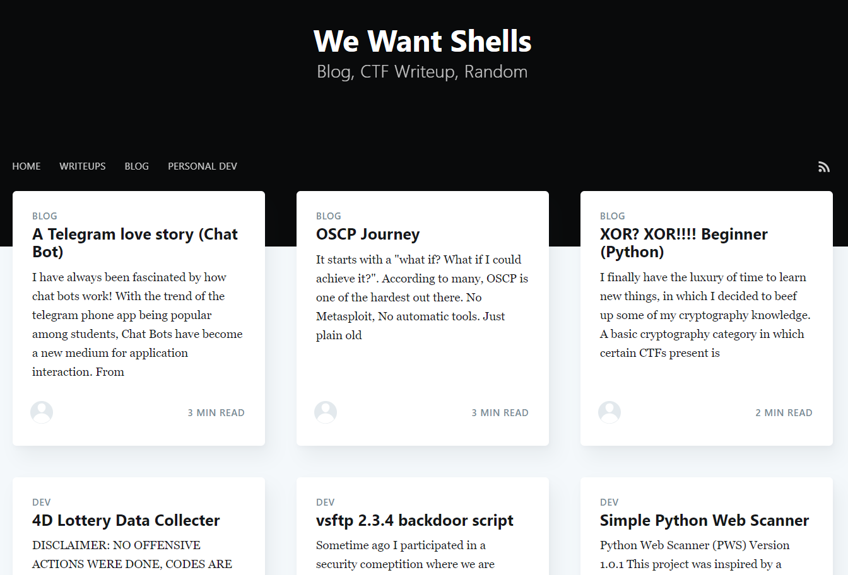
Loading a webpage in a nutshell
Webpages are able to load because of the HTML tags and entities it receives.
Your browser recognizes these tags and entities in which it will render the designs and present it to you as it is.
Remember, YOUR browser REQUESTS a copy of the webpage!
Example website

Slide 8
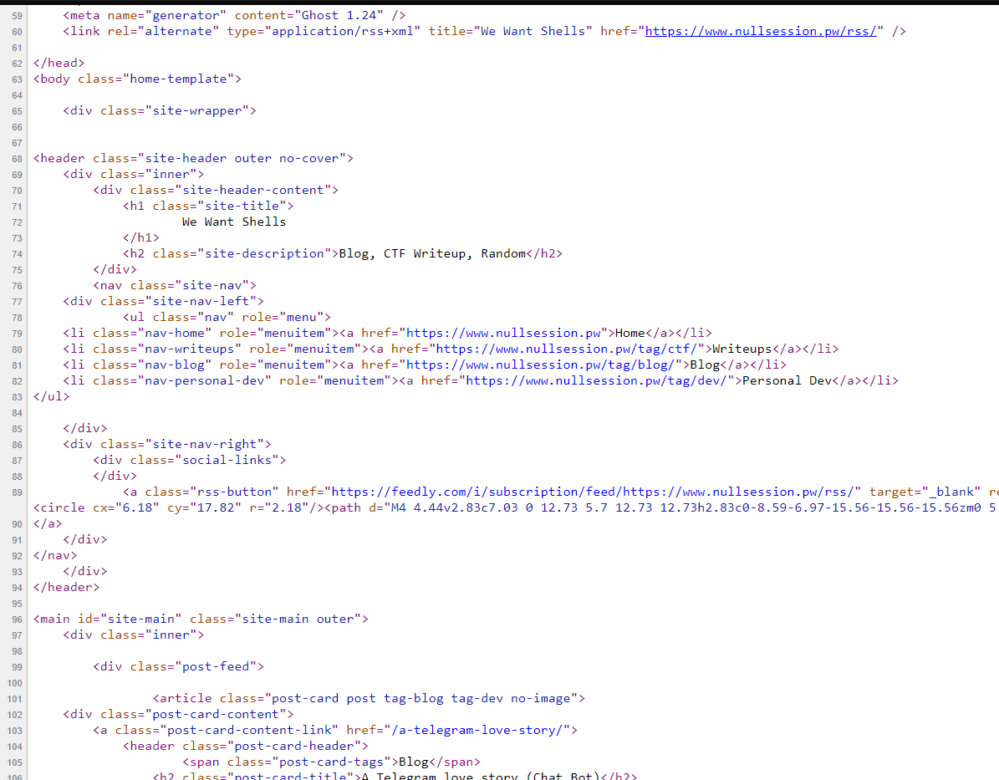
Loading a webpage in a nutshell
Since your browser have a copy of the webpage, you are able to view its source code!
Therefore, clumsy developers who leave out comments with sensitive data during development will have it exposed here!
Right Click → View source
OR
CTRL + U (Windows)
HTML Source Example

Slide 9
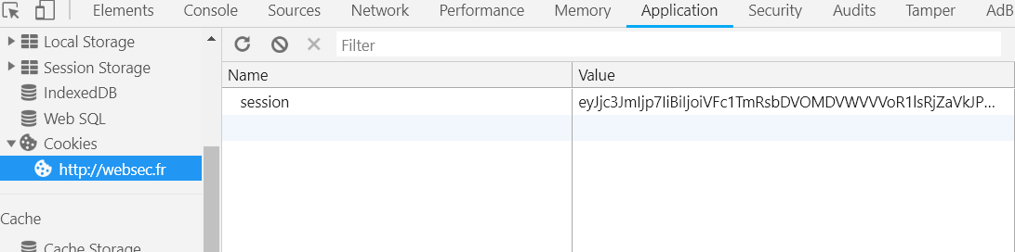
Web Cookie (Cookie monster?)
Cookies are values stored on YOUR browser.
In some cases, it is being used for identity management or session identification
Interestingly, cookies are being used to track user as well.
Web Cookie Example

Slide 10
Web Cookie (Cookie monster?)
Cookies are CHANGEABLE in some cases.
Which means some if an application does not sanitize a cookie input or have the correct cookie settings, it may result in unwanted behaviours in the web application.
What if I changed user role from USER to ADMIN?
Web Cookie Example

Slide 11
So how do WE talk to the Web?
There are many types of request which you can make to a website.
GET
POST
OPTIONS
PUT
DELETE
..
..

Slide 12
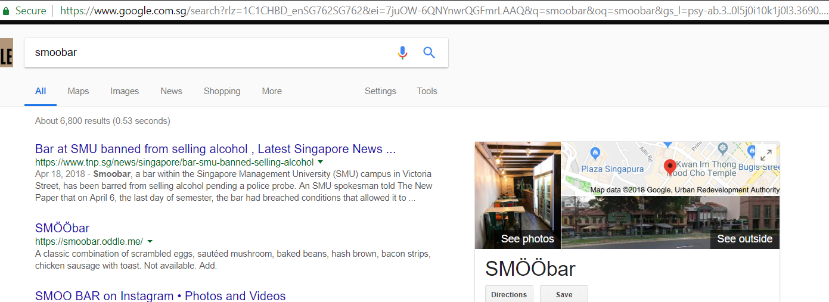
So how do WE talk to the Web?
GET Request
Data field is IN the URL.

Slide 13
So how do WE talk to the Web?
../search?rlz=1C1..
GET Request
Data field is IN the URL.

Slide 14
So how do WE talk to the Web?
../search?rlz=1C1..
‘search’ is a function in Google
‘1C1..’ is the value of the variable ‘rlz’
‘rlz’ is a variable

Slide 15
So how do WE talk to the Web?
Since variables exist in the GET parameter, you can pass values IN the URL.

Slide 16
So how do WE talk to the Web?
Making it possible for you to copy and paste! Try to copy and paste a google search URL to a new web page!

Slide 17
So how do WE talk to the Web?
*Note: Data received by the web from GET requests are plaintext.

Slide 18
So how do WE talk to the Web?
and yes, to have multiple values, it is separated by the ‘&’
var1=a&var2=b

Slide 19
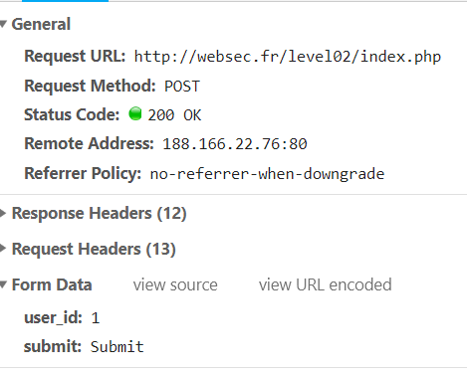
So how do WE talk to the Web?
POST Request
Data field is IN the POST REQUEST BODY.

Slide 20
So how do WE talk to the Web?
POST Request
Data field is IN the POST REQUEST BODY.

Slide 21
So how do WE talk to the Web?
Values are NOT visible in URL.
They are ENCAPSULATED in a HTTP POST REQUEST.

Slide 22
So how do WE talk to the Web?
Therefore, usually login page usually use POST request instead. WHY?

Slide 23
So how do WE talk to the Web?
In a GET request, variables and values are visible in the URL.

Slide 24
So how do WE talk to the Web?
In a POST request, variables and values are NOT visible in the URL. But..

Slide 25
So how do WE talk to the Web?
POST variables and values can still be sniffed if sent in a non-secure channel.(Using HTTP instead of HTTPS)

Slide 26
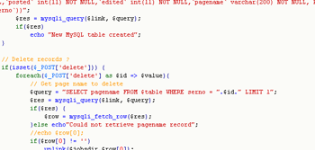
PHP
One of the popular web application language
Output sent back to client is RENDERED HTML.
Meaning, it has been processed at the server before sending it over.
PHP Source sample

Slide 27
PHP
Not going to confuse you with what you have already learnt.
But you need to know some IRREGULARITIES in PHP.

Slide 28
PHP
The infamous,
Double equal comparison in PHP
==
It tries to compare two values after trying to convert them.

Slide 29
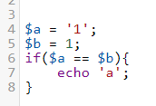
PHP
The infamous,
Double equal comparison in PHP
==
It tries to compare two values after trying to convert them.

Slide 30
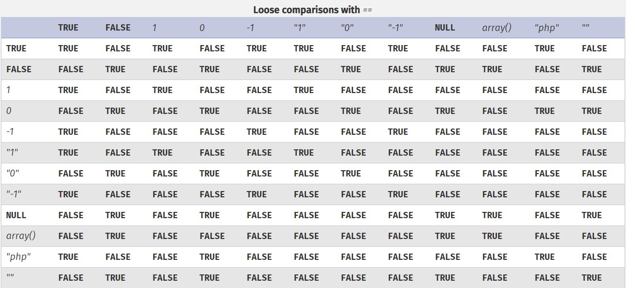
PHP

Slide 31
PHP
More info the comparison type for the PHP:
http://php.net/manual/en/types.comparisons.php

Slide 32
Hands On
Some fun?

Slide 33
This week’s theme
Basic Web

